Slide 1
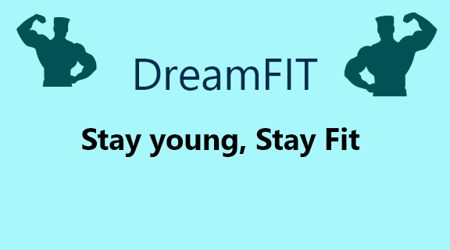

Slide 2
DreamFIT Live Longer, Live Happy
Motivation
Stay Young
Stay Happy
Relieve from your Stress
Manage your Time
Stay Healthy
Build your body at your own comfort zones
Improve yourself

Slide 3
Features to provide:
Teaching methods of how meditation works
Exercise routines or custom 1 – 1 decisions with bot or 1-1 conversation with our fitness professionals
Providing best means for dieting plans, also can customize according to preference, if any doubts could make conversation with our dieticians.
We provide wake – up calls for motivation, when your screen is woke up, we’ll be giving you motivation what to do the next.
Custom timers for exercises
Teaches you how to manage time and how to utilize your 86,400 seconds.
Virtual Exercising Assistance using latest technologies with the help of AR, VR, AI, etc.

Slide 4
Meditation

